Slide 1

Data breaches
By: Nicholas Poh (220655D)
DSF2204

Slide 2
What are Data Breaches?
A data breach is an incident where information is stolen or taken from a system without the knowledge or authorization of the system’s owner.
Examples of data that can be leaked due to a data breach are sensitive, proprietary, or confidential information such as credit card numbers, personal particulars, trade secrets or even matters of national security.

Slide 3
What causes data breaches?
Weak and stolen credentials
Stolen passwords are the most common cause of data breaches. Many people use simple, easy to guess passwords across numerous accounts which allows hackers to easily gain access to their sensitive information
Application Vulnerabilities
No software has no bugs and vulnerabilities, hackers can exploit these bugs to gain unauthorised access to the data stored within the software, harming any organization that uses the software
Malware
Different types of malware can be used to facilitate a data breach. For example, a keylogger can be used to track what a user types into a device and record important data credentials or spyware, which can steal private data while being completely undetected.

Slide 4
The Effects of Data Breaches
Organization | Individual
Financial Impact Compensating impacted consumers, looking into the data breach, investing in new security measures, and paying the necessary legal fees are just a few examples of the costs that might be incurred. Damage to Reputation The company that has been compromised may suffer irreparable harm and a decline in customer confidence as a result of this bad news. Loss of Productivity Depending on the severity of a data breach, the time taken for investigations and repairs can take days or even weeks. This downtime results in large loss in productivity and therefore revenue for the organization. | Financial Loss Data breach could result in individuals’ bank information being leaked and being accessed by unauthorised attackers. Emotional Distress Upon having their personal information leaked, individuals would be under large amounts of stress and anxiety due to the loss of their privacy. Identity Theft In the event of a data breach, unauthorised hackers can gain access to peoples’ personal information such as bank account details and passwords in order to pose as them.

Slide 5
Ways to Prevent Data Breaches
Educate employees
Implementing suitable access control
Maintain up-to-date security software
Encrypt data

Slide 6
Five Data Breach Statistics Worth Knowing
About 33% of Singapore organisations suffered up to $1.348m ($US 1m) in both direct and indirect damages as they record breaches to their data, DNS security and management firm, Infoblox, said.
A recent Ponemon Institute survey estimates 47 percent of all American adults have been affected by data breaches in the last year, with an estimated 432 online accounts being affected.
There were 4,145 publicly disclosed breaches that exposed over 22 billion records in 2021, the number of undisclosed breaches is estimated to be around 1000.
The retail industry was the number one target, with nearly 22 percent of network intrusions occurring at retailers, according to the Verizon Data Breach Investigation Report.
If it were measured as a country, then cybercrime — which is predicted to inflict damages totaling $6 trillion USD globally in 2021 — would be the world's third-largest economy after the U.S. and China.

Slide 7
Case study: Yahoo! Data breach

Slide 8
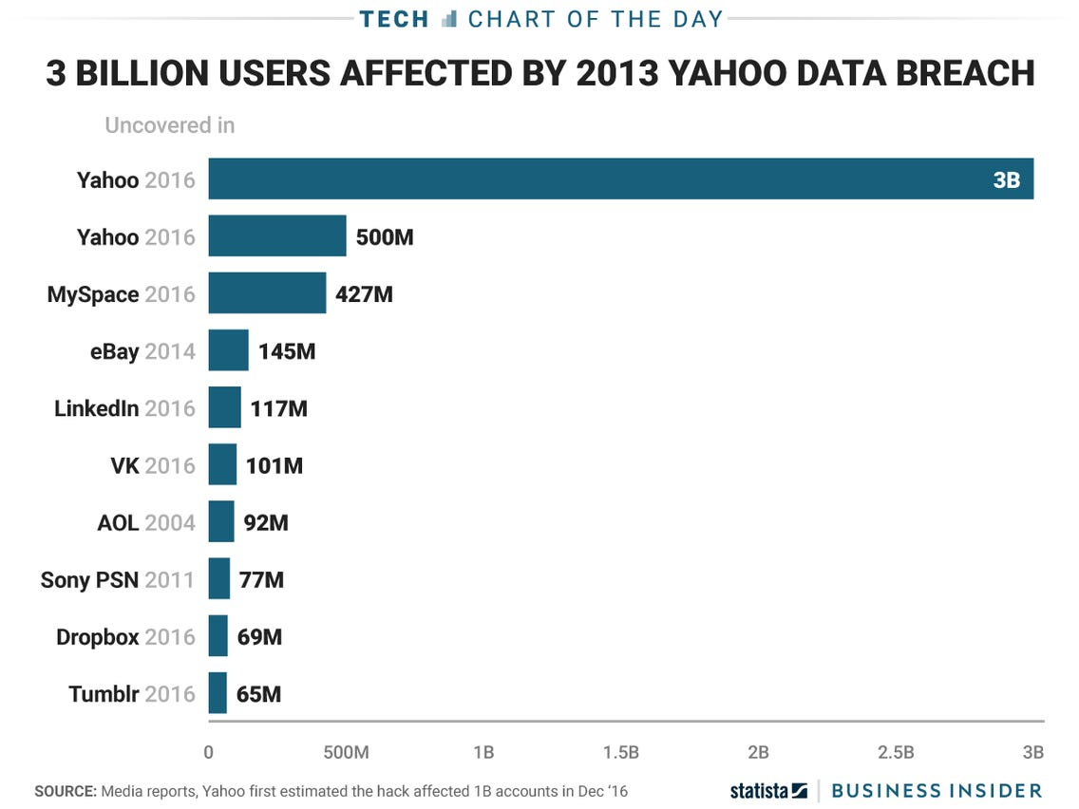
Year of breach: 2013 – 2016 Number of users affected: 3 billion user accounts
According to data breach statistics, the largest data breach in history is the one that Yahoo! suffered for several years. This data breach took place over the course of three years and the company suffered multiple attacks.
In September 2016, Yahoo! reported that 500 million user accounts had been leaked in a 2014 data breach. In December 2016, Yahoo! discovered another breach that occurred in August 2013, bringing the estimated number of accounts affected to 1 billion. After FBI involvement, it was determined that 3 billion Yahoo! accounts were comprised over the years.

Slide 9
How did the data breach happen?
The hack of Yahoo! users was orchestrated by two hackers, Latvian Alexey Belan and Canadian Karim Baratov. They were hired by Russia’s Federal Security Service, the FSB, to get their hands on information belonging to several high-profile persons. The hacking duo targeted Russian journalists, employees of a Russian cybersecurity company, and Russian officials. Other targets of what turned out to be the biggest data breach ever were the CTO of a French transportation company, a Shanghai-based managing director of a US private equity firm, a Nevada gaming official, and 14 employees of a Swiss Bitcoin banking firm.
Belan and Baratov sent Yahoo! employees a series of spear-phishing emails containing a malware download link. All it took for hackers to gain access to the company’s network was a single click by one staff member.
Once they were inside the network, their goal was to find the user database and internal tools that were used to alter the data. They quickly accomplished both goals of this major cyber attack. Making sure not to lose access to the network, they created a back door on a Yahoo! server. They returned in December 2014 to download a copy of the entire user database.

Slide 10
Aftermath
When the company realized it was a victim of the biggest hack of all time and notified everyone with a Yahoo! account, the public was shocked. A class action lawsuit ensued. Under the terms of settlement, Yahoo! has agreed to create a settlement fund worth $117,500,000 to compensate for the damage it caused American and Israeli users. Affected individuals can opt for at least two years of credit monitoring services that include identity-theft monitoring or a cash reimbursement ranging from less than $100 to a maximum of $358.80. As for the perpetrators of the Yahoo! breach, Baratov was sentenced to 5 years in prison and a fine of $2.25 million. Belan is still at large, as are the duo’s FSB collaborators.

Slide 11
References
https://www.trendmicro.com/vinfo/us/security/definition/data-breach
https://dataprot.net/articles/biggest-data-breaches/
https://cybersecurityventures.com/cybercrime-damages-6-trillion-by-2021/#:~:text=Special%20Report%3A%20Cyberwarfare%20In%20The%20C%2DSuite.&text=If%20it%20were%20measured%20as,after%20the%20U.S.%20and%20China.
https://paysimple.com/blog/how-to-prevent-data-breach/
https://www.itgovernance.eu/blog/en/the-most-common-causes-of-data-breaches-and-how-you-can-spot-them#:~:text=1.,gain%20access%20to%20sensitive%20information.
https://ico.org.uk/for-organisations/guide-to-data-protection/guide-to-the-general-data-protection-regulation-gdpr/personal-data-breaches/

